Slide 1

HGF for Behavioural Analysis: Perceptual Model for Anxiety Patients During Lockdown
Branca Francesco, Menini Davide, Sangalli Sara

Slide 2








Motivation: Lockdown in Italy
Lack of healthcare goods
Project Idea
Tests
Tests
Today
Mar
Apr
May
Jun
2020
Lockdown
Phase 2
Notes:
We would like to briefly present the context that led us to the idea for this project. We are 3 Italian students whose families have lived the lockdown in first person. We wanted to gather our personal experience with the subject of the course.
lack of healthcare goods which led to a general concern whithin the population
this brought us to our idea

Slide 3

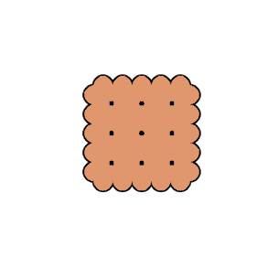











Goal: HGF for Anxiety Recognition
= Healthy Controls
= Anxious Patients
GOAL
Impartial Test
webapp
HGF
Psychologically Involving Test
webapp
HGF
Anxiety Quiz
webapp
HGF
Ground Truth
Notes:
3 test: 1 impartial, 1 involving, 1 anxiety quiz which we are going to describe later.
These three tests are delivered to the agents a webapp developed by us, in order to make the experiment more accessible to a wider pool of users.
Then we collect their results and we analyse them with HGF library.
Our goal is to compare the clustering of the two tests with the ground truth provided by the anxiety quiz: ideally the involving test provides results consistent with the ground truth, while the impartial test provides more random results, when compared to our GT.

Slide 4
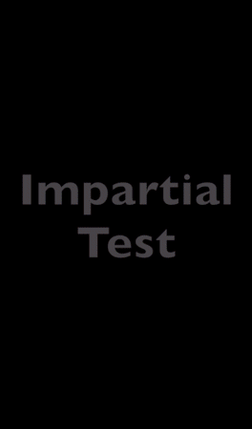
Experiment: Setup
Anxiety Quiz: 20 questions based on STAI. * 5 levels of anxiety detected, but only interested in a binary decision for results’ validation.
Impartial Test: Biscuits in shop A (y | n) Are there biscuits in shop B?
Involving Test: Sanitizers in shop A (y | n) Are there sanitizers in shop B?
* https://en.wikipedia.org/wiki/State-Trait_Anxiety_Inventory
Notes:
more in details
interface presented to our subjects
the other two tests are structured in the same way: the user imagines to be in a daily situation at the supermarket, where they have to buy a certain good, which may or may not be present there. they are asked to guess whether the same good is present or not in a nearby supermarket and they are shown the correct answer. all these inputs are provided as visual cues, as you can see in the demo.
The difference between the two tests relies on the involved good: biscuits for the impartial context, hand sanitizer for the involving one.

Slide 5
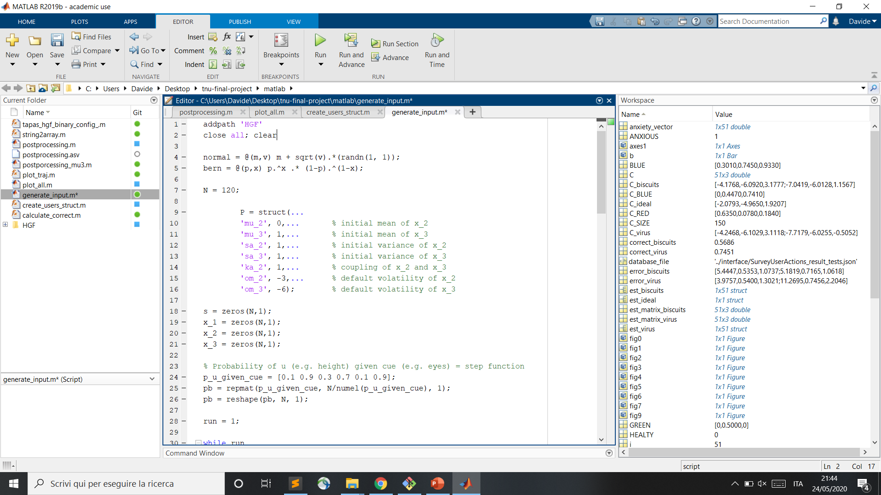
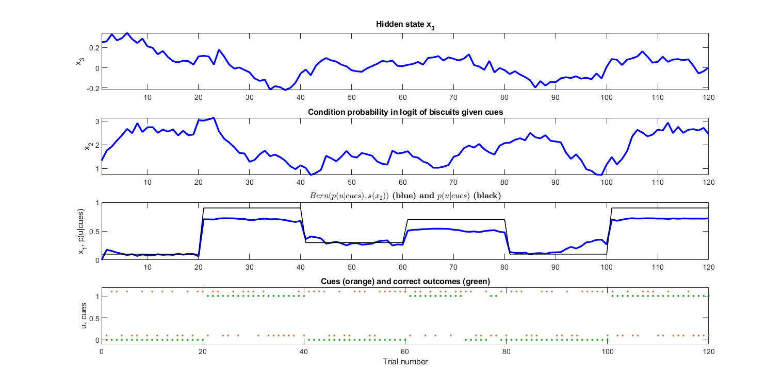
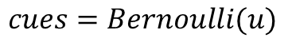
Experiment: Inputs
Correct Outcomes:
Cues:
$$u=GenerativeModel(P, p(u|cues))$$
$$cues=Bernoulli(u)$$
Notes:
the correct outcomes are produced by a generative model which takes as input some parameters and the probability of outcomes themselves, given the cues. in particular this probability is shown here with the black line and it's a step function. (used to control the bernoulli distribution in the generative model).
the output of the generative model is shown with the blue line, which then we binarize and are plot here with the green dots.
the cues are produced backwards via a bernoulli distribution of the correct outcomes and they are shown with the orange dots.

Slide 6
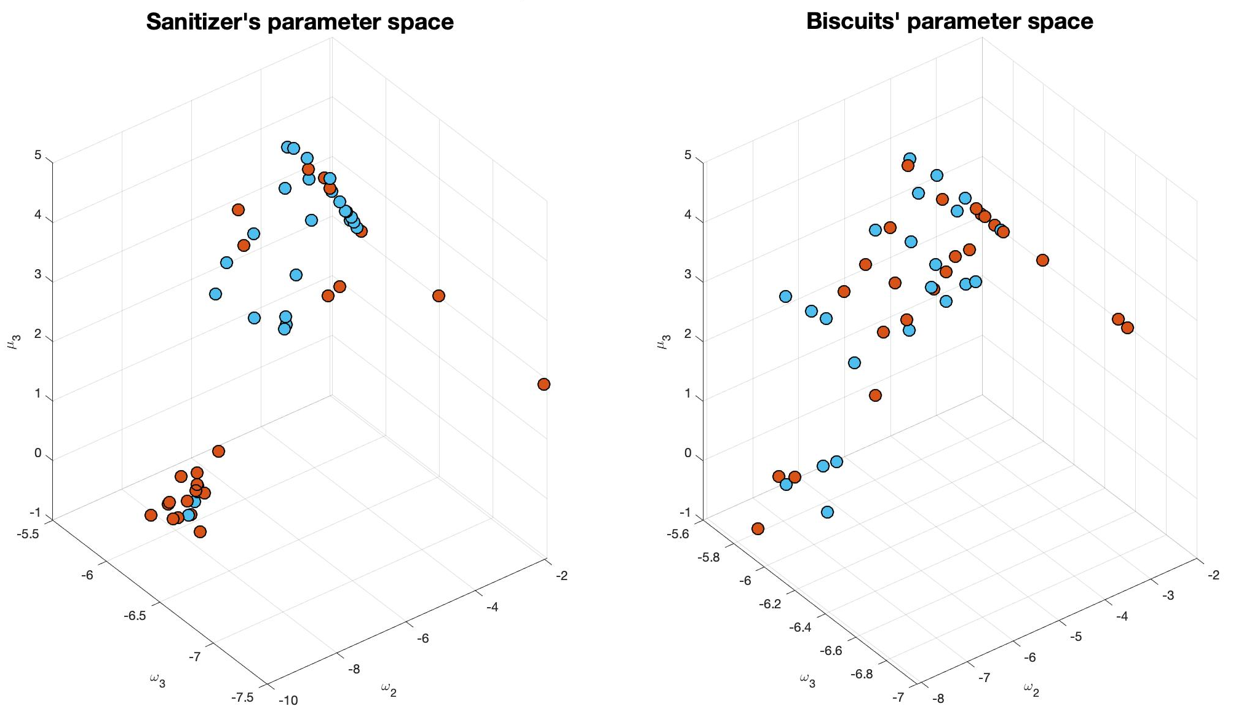
Parameters’ Estimation: Involving vs. Impartial
= Healthy Controls
= Anxious Patients
Notes:
We carry out an estimation of three parameters: the two default volatilities of the hidden states and the initial value of the random walk (mean value of the normal distribution of state_3).
These parameters are shown on the axes of the two graphs, which depict the distribution of the user in the parameter space.
As you can notice, the involving test presents two more visible regions, while the impartial test presents more a spread and chaotic point cloud.
Anyway, we can see that over the total number of tests, according to he ground truth, almost half of the subjects turned out to be anxious.

Slide 7
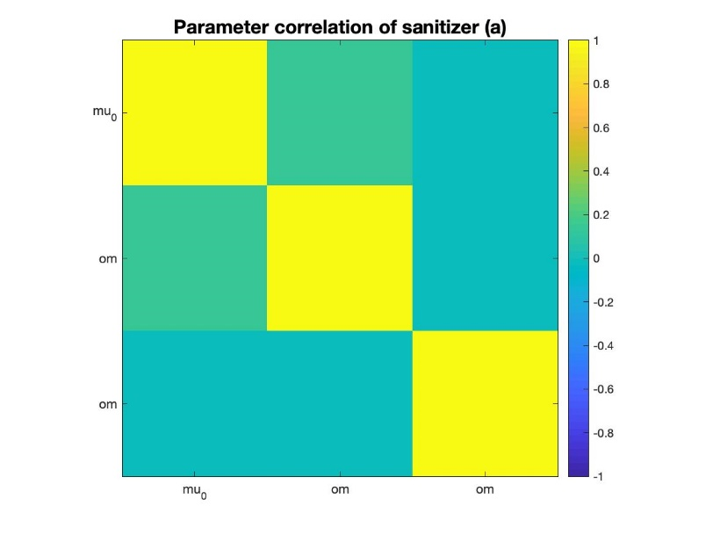
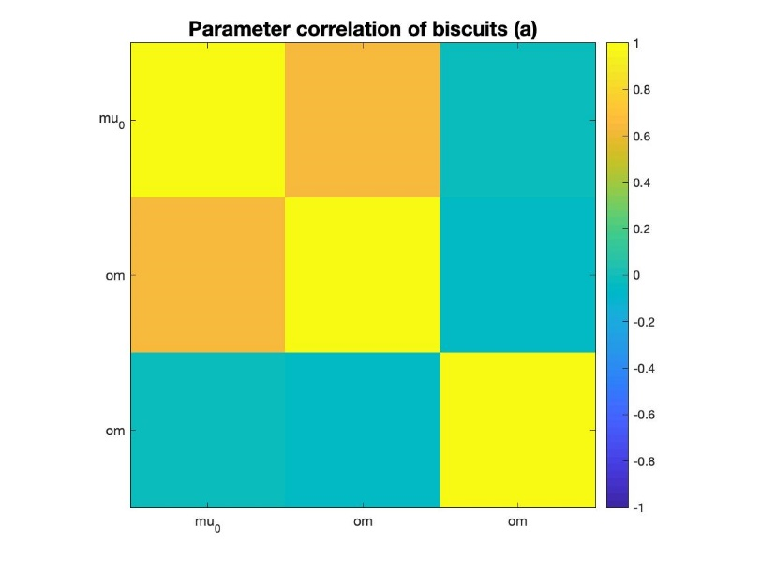
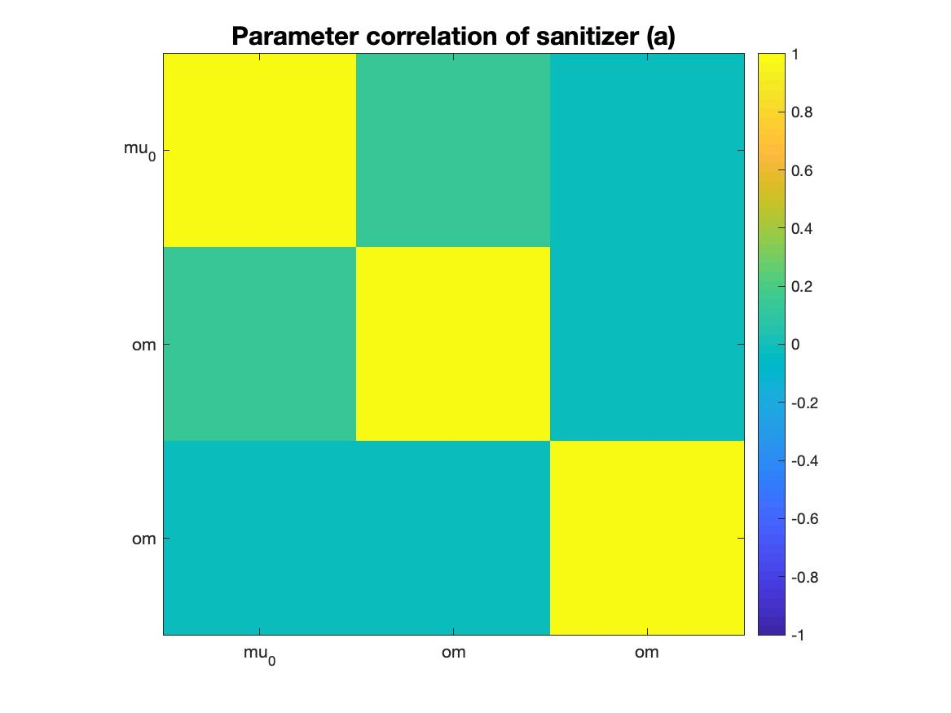
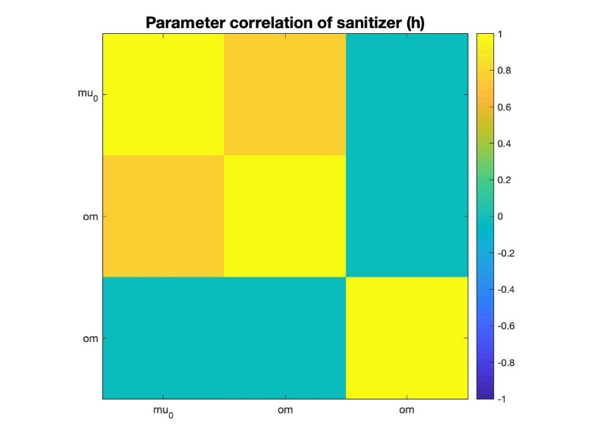
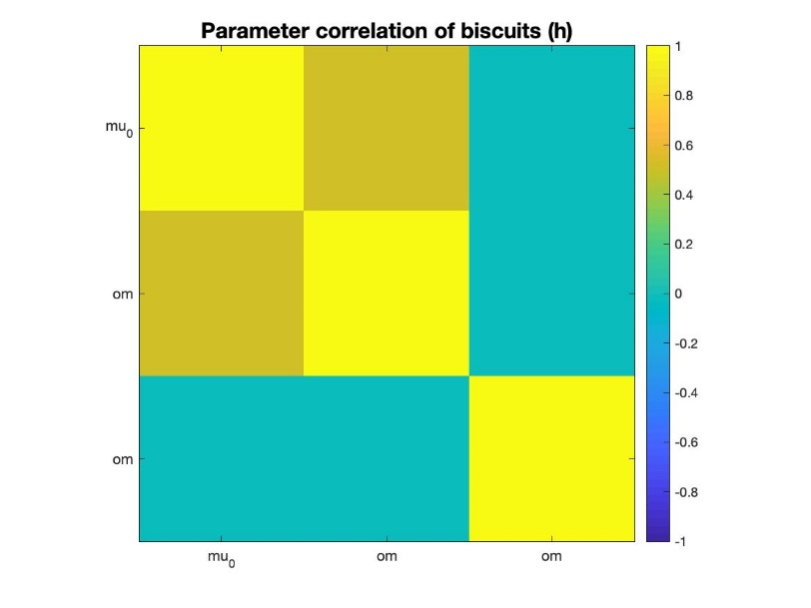
Parameters’ Correlation
Anxious
Healthy
Involving
Impartial
Notes:
Moreover, regarding the parameter, we carried out an analysis on their correlation in the different configurations. In all the cases, as you can see, they are never correlated and in this way they independently identifiable. Consequently, changing a parameter is never fully equivalent to change another one.
(Including a readout of mu3 in the response model allows to get rid of the indeterminacy observed when using other models we tested during exercises.)

Slide 8
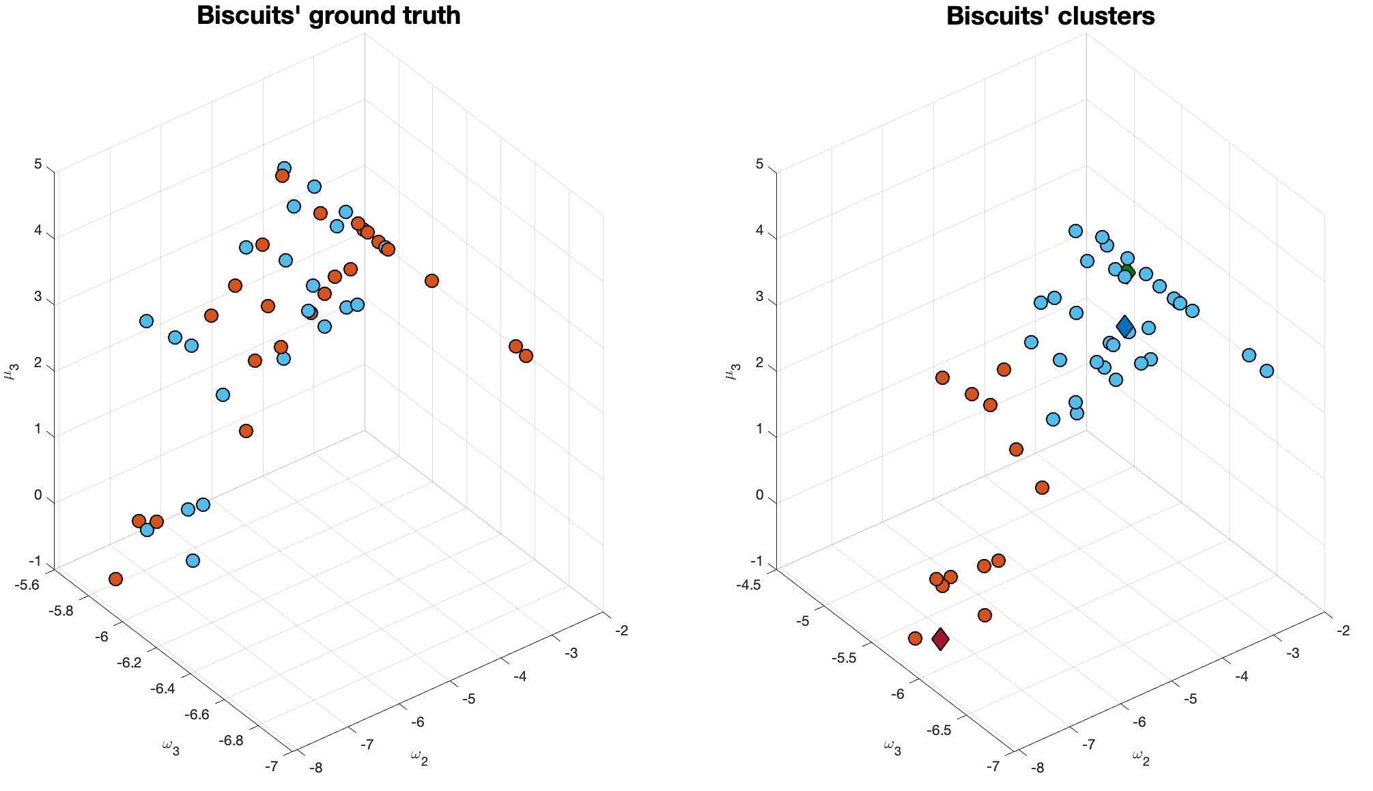
K-Means Clustering: Impartial Context
= Healthy Controls
= Anxious Patients
= Healthy Centroid
= Anxious Centroid
= Ideal Model
Notes:
Starting from the estimation of the parameters, we carry out K-means clustering to distinguish the healthy controls and the anxiety patients and we compare the obtained results to our ground truth. on the left you can see the ground truth, while on the right there is output of the kmeans.
We can see that in the impartial context the accuracy obtained is quite low, very close to 50%, which means that in an impartial context all the users behave in a very similar way.
Here there is a visual aid to identify the centroids of the clusters and the parameters of the ideal model in green.

Slide 9
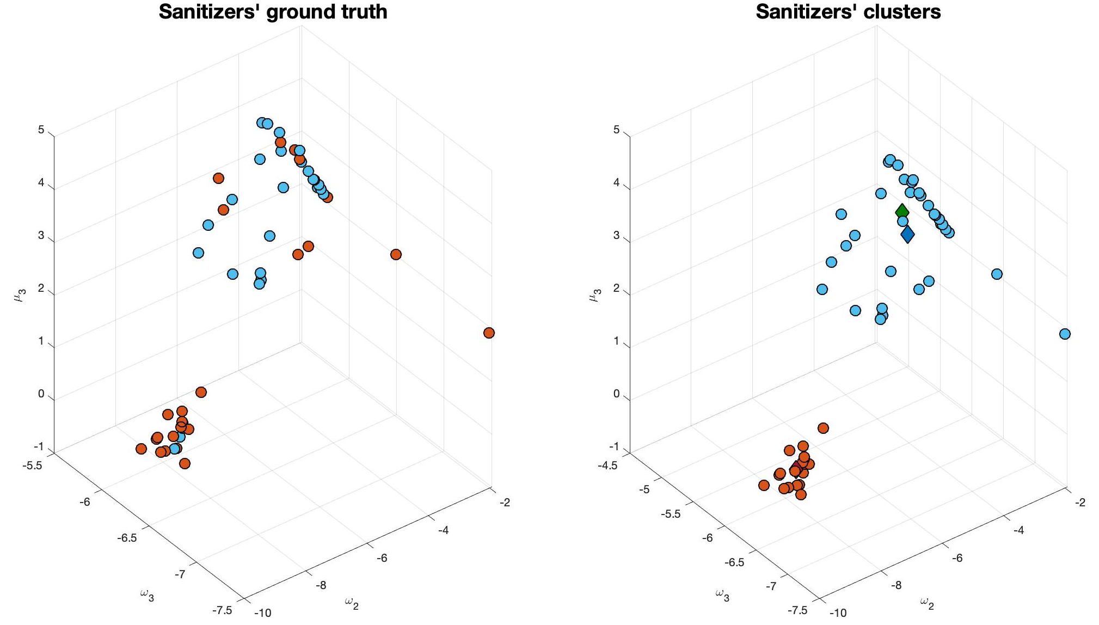
K-Means Clustering: Involving Context
= Healthy Controls
= Anxious Patients
= Healthy Centroid
= Anxious Centroid
= Ideal Model
Notes:
Here the same graphs are shown for the involving scenario. as you can see the behaviour of the kmeans is way more consistent with the ground truth, leading to an accuracy of 76%. This means that our hypothesis is verified and, as supposed, in a psychologically involving contexts the two groups behave differently.
Moreover, the estimation of the ideal parameters is closer to the healthy controls, which could possibly mean that the anxious people tend to drift from the ideal behaviour.

Slide 10
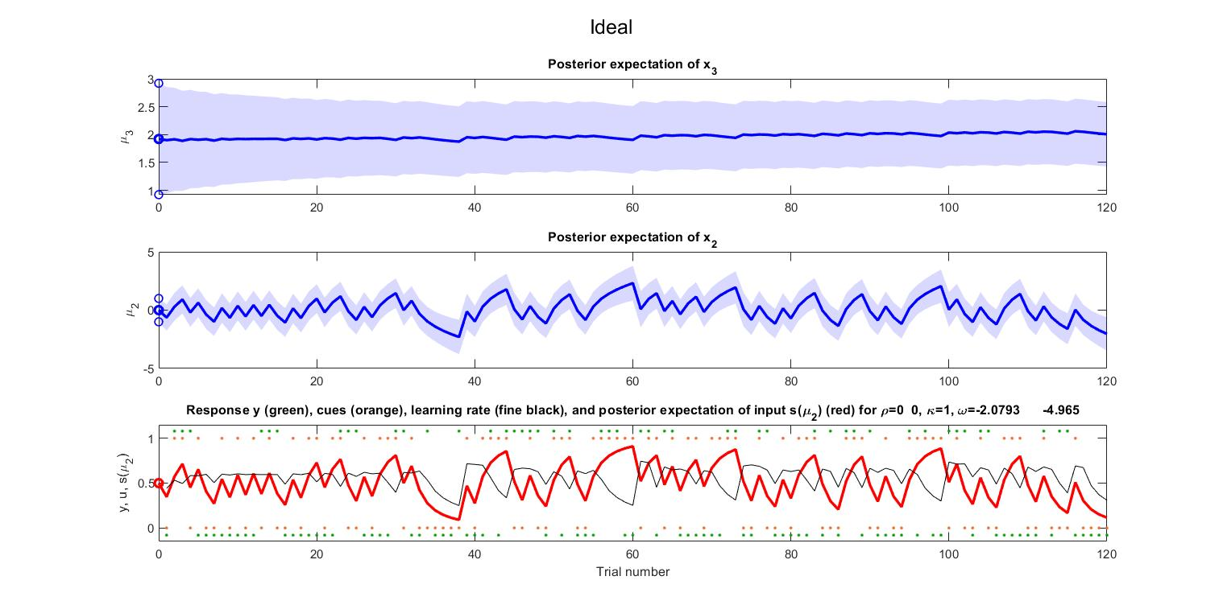
Simulation of the Ideal Model
Notes:
Here we analyse the ideal response, from the top to the bottom you can see the hidden states in blue and the response in red.

Slide 11
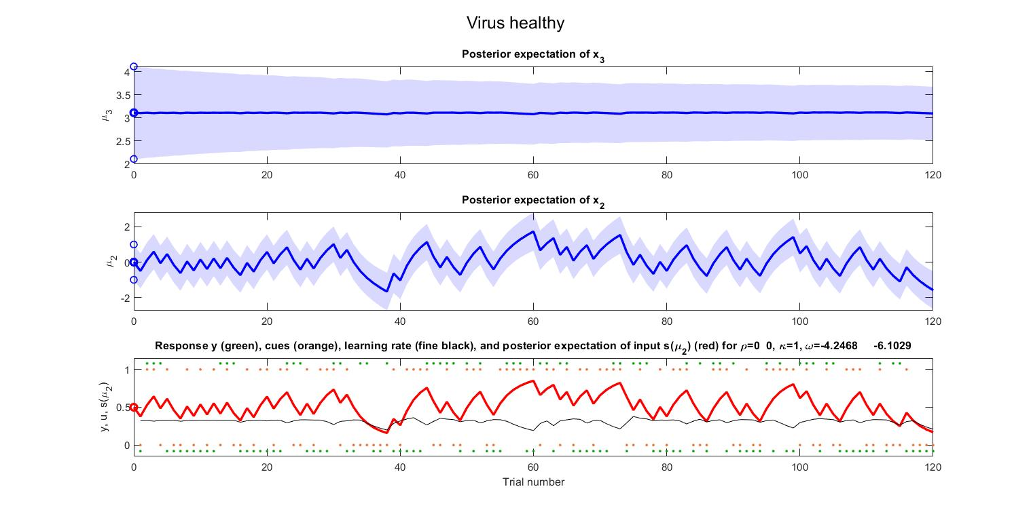
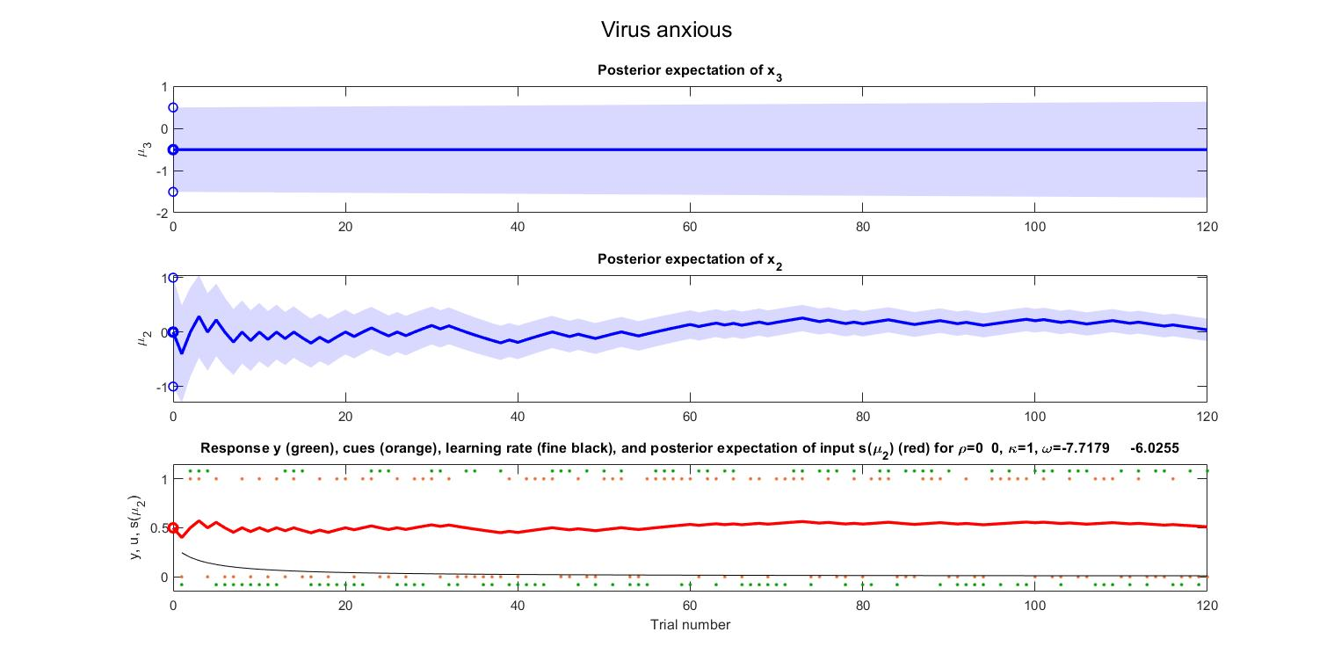
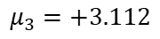
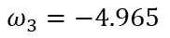
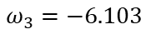
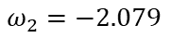
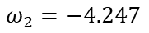
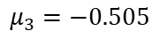
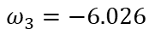
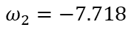
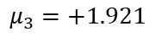
Comparison: Ideal vs. Involving Test’s Centroids
Ideal
SCORE = 53%
$$ω_{2}=−2.079$$
$$ω_{3}=−4.965$$
$$μ_{3}=+1.921$$
Healthy
SCORE = 50%
$$ω_{2}=−4.247$$
$$ω_{3}=−6.103$$
$$μ_{3}=+3.112$$
Anxious
SCORE = 46%
$$ω_{2}=−7.718$$
$$ω_{3}=−6.026$$
$$μ_{3}=−0.505$$
Notes:
In relation to this, we compare the simulations of the healthy and anxious centroids, which better represent the two classes.
This kind of responses, compared to the correct outcomes, leads to these scores, which, again confirm our hypothesis, because the healthy controls have higher score when compared to the anxious patients.

Slide 12
Final Results: Summary
All the subjects behave in similar ways in an impartial context
Healthy Controls behave differently than Anxious Patients in a psychologically involving context
Healthy Controls have a higher score, closer to the ideal model
Clustering and scores support our hypothesis of anxiety during lockdown in Italy

Slide 13

Thank you for your attention!
Branca, Francesco – fbranca@student.ethz.ch
Menini, Davide – dmenini@student.ethz.ch
Sangalli, Sara – sansara@student.ethz.ch
https://tnutest.altervista.org/

Slide 14
Back-Up Slides

Slide 15
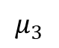
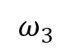
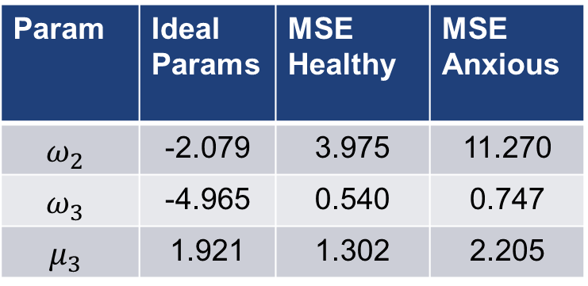
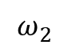
Comparison: MSE (Involving Test)
$$=MSE\left(est_ideal, est_h\left(i\right)\right) for i=1..N_h$$
$$=MSE\left(est_ideal,est_a\left(i\right)\right) for i=1..N_a$$
Healthy and anxious groups are based on ground truth
Param | Ideal Params | MSE Healthy | MSE Anxious
$$ω_{2}$$ | -2.079 | 3.975 | 11.270
$$ω_{3}$$ | -4.965 | 0.540 | 0.747
$$μ_{3}$$ | 1.921 | 1.302 | 2.205
$$ω_{2}$$
$$ω_{3}$$
$$μ_{3}$$

Slide 16
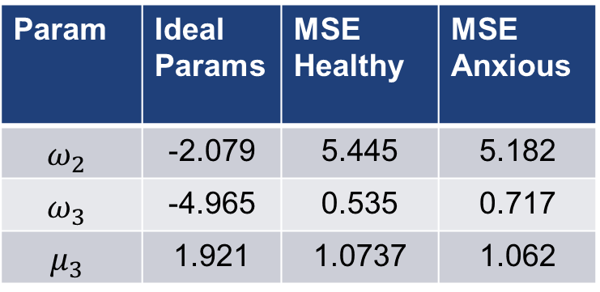
Comparison: MSE (Impartial Test)
$$=MSE\left(est_ideal, est_h\left(i\right)\right) for i=1..N_h$$
$$=MSE\left(est_ideal,est_a\left(i\right)\right) for i=1..N_a$$
Healthy and anxious groups are based on ground truth
Param | Ideal Params | MSE Healthy | MSE Anxious
$$ω_{2}$$ | -2.079 | 5.445 | 5.182
$$ω_{3}$$ | -4.965 | 0.535 | 0.717
$$μ_{3}$$ | 1.921 | 1.0737 | 1.062
$$ω_{2}$$
$$ω_{3}$$
$$μ_{3}$$

